Slide 1
Pointers
*
Programming and Data Structure
‹#›

Slide 2
Introduction
A pointer is a variable that represents the location (rather than the value) of a data item.
They have a number of useful applications.
Enables us to access a variable that is defined outside the function.
Can be used to pass information back and forth between a function and its reference point.
More efficient in handling data tables.
Reduces the length and complexity of a program.
Sometimes also increases the execution speed.
*
Programming and Data Structure
‹#›

Slide 3
Basic Concept
Within the computer memory, every stored data item occupies one or more contiguous memory cells.
The number of memory cells required to store a data item depends on its type (char, int, double, etc.).
Whenever we declare a variable, the system allocates memory location(s) to hold the value of the variable.
Since every byte in memory has a unique address, this location will also have its own (unique) address.
*
Programming and Data Structure
‹#›

Slide 4
Contd.
Consider the statement
int xyz = 50;
This statement instructs the compiler to allocate a location for the integer variable xyz, and put the value 50 in that location.
Suppose that the address location chosen is 1380.
xyz 🡺 variable
50 🡺 value
1380 🡺 address
*
Programming and Data Structure
‹#›

Slide 5
Contd.
During execution of the program, the system always associates the name xyz with the address 1380.
The value 50 can be accessed by using either the name xyz or the address 1380.
Since memory addresses are simply numbers, they can be assigned to some variables which can be stored in memory.
Such variables that hold memory addresses are called pointers.
Since a pointer is a variable, its value is also stored in some memory location.
*
Programming and Data Structure
‹#›

Slide 6
Contd.
Suppose we assign the address of xyz to a variable p.
p is said to point to the variable xyz.
Variable Value Address
xyz 50 1380
p 1380 2545
p = &xyz;
2545
1380
1380
50
p
xyz
*
Programming and Data Structure
‹#›

Slide 7
Accessing the Address of a Variable
The address of a variable can be determined using the ‘&’ operator.
The operator ‘&’ immediately preceding a variable returns the address of the variable.
Example:
p = &xyz;
The address of xyz (1380) is assigned to p.
The ‘&’ operator can be used only with a simple variable or an array element.
&distance
&x[0]
&x[i-2]
*
Programming and Data Structure
‹#›

Slide 8
Contd.
Following usages are illegal:
&235
Pointing at constant.
int arr[20];
:
&arr;
Pointing at array name.
&(a+b)
Pointing at expression.
*
Programming and Data Structure
‹#›

Slide 9
Example
#include <stdio.h>
main()
{
int a;
float b, c;
double d;
char ch;
a = 10; b = 2.5; c = 12.36; d = 12345.66; ch = ‘A’;
printf (“%d is stored in location %u \n”, a, &a) ;
printf (“%f is stored in location %u \n”, b, &b) ;
printf (“%f is stored in location %u \n”, c, &c) ;
printf (“%ld is stored in location %u \n”, d, &d) ;
printf (“%c is stored in location %u \n”, ch, &ch) ;
}
*
Programming and Data Structure
‹#›

Slide 10
Output:
10 is stored in location 3221224908
2.500000 is stored in location 3221224904
12.360000 is stored in location 3221224900
12345.660000 is stored in location 3221224892
A is stored in location 3221224891
a
b
c
d
ch
Incidentally variables a,b,c,d and ch are allocated
to contiguous memory locations.
*
Programming and Data Structure
‹#›

Slide 11
Pointer Declarations
Pointer variables must be declared before we use them.
General form:
data_type *pointer_name;
Three things are specified in the above declaration:
The asterisk (*) tells that the variable pointer_name is a pointer variable.
pointer_name needs a memory location.
pointer_name points to a variable of type data_type.
*
Programming and Data Structure
‹#›

Slide 12
Contd.
Example:
int *count;
float *speed;
Once a pointer variable has been declared, it can be made to point to a variable using an assignment statement like:
int *p, xyz;
:
p = &xyz;
This is called pointer initialization.
*
Programming and Data Structure
‹#›

Slide 13
Things to Remember
Pointer variables must always point to a data item of the same type.
float x;
int *p;
: 🡺 will result in erroneous output
p = &x;
Assigning an absolute address to a pointer variable is prohibited.
int *count;
:
count = 1268;
*
Programming and Data Structure
‹#›

Slide 14
Accessing a Variable Through its Pointer
Once a pointer has been assigned the address of a variable, the value of the variable can be accessed using the indirection operator (*).
int a, b;
int *p;
:
p = &a;
b = *p;
Equivalent to
b = a
*
Programming and Data Structure
‹#›

Slide 15
Example 1
#include <stdio.h>
main()
{
int a, b;
int c = 5;
int *p;
a = 4 * (c + 5) ;
p = &c;
b = 4 * (*p + 5) ;
printf (“a=%d b=%d \n”, a, b) ;
}
Equivalent
*
Programming and Data Structure
‹#›

Slide 16
Example 2
#include <stdio.h>
main()
{
int x, y;
int *ptr;
x = 10 ;
ptr = &x ;
y = *ptr ;
printf (“%d is stored in location %u \n”, x, &x) ;
printf (“%d is stored in location %u \n”, *&x, &x) ;
printf (“%d is stored in location %u \n”, *ptr, ptr) ;
printf (“%d is stored in location %u \n”, y, &*ptr) ;
printf (“%u is stored in location %u \n”, ptr, &ptr) ;
printf (“%d is stored in location %u \n”, y, &y) ;
*ptr = 25;
printf (“\nNow x = %d \n”, x);
}
*&x⬄x
ptr=&x;
&x⬄&*ptr
*
Programming and Data Structure
‹#›

Slide 17
Output:
10 is stored in location 3221224908
10 is stored in location 3221224908
10 is stored in location 3221224908
10 is stored in location 3221224908
3221224908 is stored in location 3221224900
10 is stored in location 3221224904
Now x = 25
Address of x: 3221224908
Address of y: 3221224904
Address of ptr: 3221224900
*
Programming and Data Structure
‹#›

Slide 18
Pointer Expressions
Like other variables, pointer variables can be used in expressions.
If p1 and p2 are two pointers, the following statements are valid:
sum = *p1 + *p2 ;
prod = *p1 * *p2 ;
prod = (*p1) * (*p2) ;
*p1 = *p1 + 2;
x = *p1 / *p2 + 5 ;
*
Programming and Data Structure
‹#›

Slide 19
Contd.
What are allowed in C?
Add an integer to a pointer.
Subtract an integer from a pointer.
Subtract one pointer from another (related).
If p1 and p2 are both pointers to the same array, them p2–p1 gives the number of elements between p1 and p2.
What are not allowed?
Add two pointers.
p1 = p1 + p2 ;
Multiply / divide a pointer in an expression.
p1 = p2 / 5 ;
p1 = p1 – p2 * 10 ;
*
Programming and Data Structure
‹#›

Slide 20
Scale Factor
We have seen that an integer value can be added to or subtracted from a pointer variable.
int *p1, *p2 ;
int i, j;
:
p1 = p1 + 1 ;
p2 = p1 + j ;
p2++ ;
p2 = p2 – (i + j) ;
In reality, it is not the integer value which is added/subtracted, but rather the scale factor times the value.
*
Programming and Data Structure
‹#›

Slide 21
Contd.
Data Type Scale Factor
char 1
int 4
float 4
double 8
If p1 is an integer pointer, then
p1++
will increment the value of p1 by 4.
*
Programming and Data Structure
‹#›

Slide 22
Example: to find the scale factors
Returns no. of bytes required for data type representation
#include <stdio.h>
main()
{
printf (“Number of bytes occupied by int is %d \n”, sizeof(int));
printf (“Number of bytes occupied by float is %d \n”, sizeof(float));
printf (“Number of bytes occupied by double is %d \n”, sizeof(double));
printf (“Number of bytes occupied by char is %d \n”, sizeof(char));
}
Output:
Number of bytes occupied by int is 4
Number of bytes occupied by float is 4
Number of bytes occupied by double is 8
Number of bytes occupied by char is 1
*
Programming and Data Structure
‹#›

Slide 23
Passing Pointers to a Function
Pointers are often passed to a function as arguments.
Allows data items within the calling program to be accessed by the function, altered, and then returned to the calling program in altered form.
Called call-by-reference (or by address or by location).
Normally, arguments are passed to a function by value.
The data items are copied to the function.
Changes are not reflected in the calling program.
*
Programming and Data Structure
‹#›

Slide 24
Example: passing arguments by value
#include <stdio.h>
main()
{
int a, b;
a = 5 ; b = 20 ;
swap (a, b) ;
printf (“\n a = %d, b = %d”, a, b);
}
void swap (int x, int y)
{
int t ;
t = x ;
x = y ;
y = t ;
}
a and b
do not
swap
Output
a = 5, b = 20
x and y swap
*
Programming and Data Structure
‹#›

Slide 25
Example: passing arguments by reference
#include <stdio.h>
main()
{
int a, b;
a = 5 ; b = 20 ;
swap (&a, &b) ;
printf (“\n a = %d, b = %d”, a, b);
}
void swap (int *x, int *y)
{
int t ;
t = *x ;
*x = *y ;
*y = t ;
}
*(&a) and *(&b)
swap
Output
a = 20, b = 5
*x and *y
swap
*
Programming and Data Structure
‹#›

Slide 26
scanf Revisited
int x, y ;
printf (“%d %d %d”, x, y, x+y) ;
What about scanf ?
scanf (“%d %d %d”, x, y, x+y) ;
scanf (“%d %d”, &x, &y) ;
NO
YES
*
Programming and Data Structure
‹#›

Slide 27
Example: Sort 3 integers
Three-step algorithm:
Read in three integers x, y and z
Put smallest in x
Swap x, y if necessary; then swap x, z if necessary.
Put second smallest in y
Swap y, z if necessary.
*
Programming and Data Structure
‹#›

Slide 28
Contd.
#include <stdio.h>
main()
{
int x, y, z ;
………..
scanf (“%d %d %d”, &x, &y, &z) ;
if (x > y) swap (&x, &y);
if (x > z) swap (&x, &z);
if (y > z) swap (&y, &z) ;
………..
}
*
Programming and Data Structure
‹#›

Slide 29
sort3 as a function
#include <stdio.h>
main()
{
int x, y, z ;
………..
scanf (“%d %d %d”, &x, &y, &z) ;
sort3 (&x, &y, &z) ;
………..
}
void sort3 (int *xp, int *yp, int *zp)
{
if (*xp > *yp) swap (xp, yp);
if (*xp > *zp) swap (xp, zp);
if (*yp > *zp) swap (yp, zp);
}
xp/yp/zp
are
pointers
*
Programming and Data Structure
‹#›

Slide 30
Contd.
Why no ‘&’ in swap call?
Because xp, yp and zp are already pointers that point to the variables that we want to swap.
*
Programming and Data Structure
‹#›

Slide 31
Pointers and Arrays
When an array is declared,
The compiler allocates a base address and sufficient amount of storage to contain all the elements of the array in contiguous memory locations.
The base address is the location of the first element (index 0) of the array.
The compiler also defines the array name as a constant pointer to the first element.
*
Programming and Data Structure
‹#›

Slide 32
Example
Consider the declaration:
int x[5] = {1, 2, 3, 4, 5} ;
Suppose that the base address of x is 2500, and each integer requires 4 bytes.
Element Value Address
x[0] 1 2500
x[1] 2 2504
x[2] 3 2508
x[3] 4 2512
x[4] 5 2516
*
Programming and Data Structure
‹#›

Slide 33
Contd.
x ⬄ &x[0] ⬄ 2500 ;
p = x; and p = &x[0]; are equivalent.
We can access successive values of x by using p++ or p- - to move from one element to another.
Relationship between p and x:
p = &x[0] = 2500
p+1 = &x[1] = 2504
p+2 = &x[2] = 2508
p+3 = &x[3] = 2512
p+4 = &x[4] = 2516
*(p+i) gives the
value of x[i]
*
Programming and Data Structure
‹#›

Slide 34
Example: function to find average
int *array
#include <stdio.h>
main()
{
int x[100], k, n ;
scanf (“%d”, &n) ;
for (k=0; k<n; k++)
scanf (“%d”, &x[k]) ;
printf (“\nAverage is %f”,
avg (x, n));
}
float avg (int array[ ],int size)
{
int *p, i , sum = 0;
p = array ;
for (i=0; i<size; i++)
sum = sum + *(p+i);
return ((float) sum / size);
}
p[i]
*
Programming and Data Structure
‹#›

Slide 35
Structures Revisited
Recall that a structure can be declared as:
struct stud {
int roll;
char dept_code[25];
float cgpa;
};
struct stud a, b, c;
And the individual structure elements can be accessed as:
a.roll , b.roll , c.cgpa , etc.
*
Programming and Data Structure
‹#›

Slide 36
Arrays of Structures
We can define an array of structure records as
struct stud class[100] ;
The structure elements of the individual records can be accessed as:
class[i].roll
class[20].dept_code
class[k++].cgpa
*
Programming and Data Structure
‹#›

Slide 37
Example: Sorting by Roll Numbers
#include <stdio.h>
struct stud
{
int roll;
char dept_code[25];
float cgpa;
};
main()
{
struc stud class[100], t;
int j, k, n;
scanf (“%d”, &n);
/* no. of students */
for (k=0; k<n; k++)
scanf (“%d %s %f”, &class[k].roll,
class[k].dept_code, &class[k].cgpa);
for (j=0; j<n-1; j++)
for (k=j+1; k<n; k++)
{
if (class[j].roll > class[k].roll)
{
t = class[j] ;
class[j] = class[k] ;
class[k] = t
}
}
<<<< PRINT THE RECORDS >>>>
}
*
Programming and Data Structure
‹#›

Slide 38
Pointers and Structures
You may recall that the name of an array stands for the address of its zero-th element.
Also true for the names of arrays of structure variables.
Consider the declaration:
struct stud {
int roll;
char dept_code[25];
float cgpa;
} class[100], *ptr ;
*
Programming and Data Structure
‹#›

Slide 39
The name class represents the address of the zero-th element of the structure array.
ptr is a pointer to data objects of the type struct stud.
The assignment
ptr = class ;
will assign the address of class[0] to ptr.
When the pointer ptr is incremented by one (ptr++) :
The value of ptr is actually increased by sizeof(stud).
It is made to point to the next record.
*
Programming and Data Structure
‹#›

Slide 40
Once ptr points to a structure variable, the members can be accessed as:
ptr –> roll ;
ptr –> dept_code ;
ptr –> cgpa ;
The symbol “–>” is called the arrow operator.
*
Programming and Data Structure
‹#›

Slide 41
Example
#include <stdio.h>
typedef struct {
float real;
float imag;
} _COMPLEX;
swap_ref(_COMPLEX *a, _COMPLEX *b)
{
_COMPLEX tmp;
tmp=*a;
*a=*b;
*b=tmp;
}
main()
{
_COMPLEX x={10.0,3.0}, y={-20.0,4.0};
print(&x); print(&y);
swap_ref(&x,&y);
print(&x); print(&y);
}
print(_COMPLEX *a)
{
printf("(%f,%f)\n",a->real,a->imag);
}
(10.000000,3.000000)
(-20.000000,4.000000)
(-20.000000,4.000000)
(10.000000,3.000000)
*
Programming and Data Structure
‹#›

Slide 42
A Warning
When using structure pointers, we should take care of operator precedence.
Member operator “.” has higher precedence than “*”.
ptr –> roll and (*ptr).roll mean the same thing.
*ptr.roll will lead to error.
The operator “–>” enjoys the highest priority among operators.
++ptr –> roll will increment roll, not ptr.
(++ptr) –> roll will do the intended thing.
*
Programming and Data Structure
‹#›

Slide 43
Structures and Functions
A structure can be passed as argument to a function.
A function can also return a structure.
The process shall be illustrated with the help of an example.
A function to add two complex numbers.
*
Programming and Data Structure
‹#›

Slide 44
Example: complex number addition
#include <stdio.h>
struct complex {
float re;
float im;
};
main()
{
struct complex a, b, c;
scanf (“%f %f”, &a.re, &a.im);
scanf (“%f %f”, &b.re, &b.im);
c = add (a, b) ;
printf (“\n %f %f”, c.re, c.im);
}
struct complex add (x, y)
struct complex x, y;
{
struct complex t;
t.re = x.re + y.re ;
t.im = x.im + y.im ;
return (t) ;
}
*
Programming and Data Structure
‹#›

Slide 45
Example: Alternative way using pointers
#include <stdio.h>
struct complex {
float re;
float im;
};
main()
{
struct complex a, b, c;
scanf (“%f %f”, &a.re, &a.im);
scanf (“%f %f”, &b.re, &b.im);
add (&a, &b, &c) ;
printf (“\n %f %f”, c,re, c.im);
}
void add (x, y, t)
struct complex *x, *y, *t;
{
t->re = x->re + y->re ;
t->im = x->im + y->im ;
}
*
Programming and Data Structure
‹#›

Slide 46
Dynamic Memory Allocation
*
Programming and Data Structure
‹#›

Slide 47
Basic Idea
Many a time we face situations where data is dynamic in nature.
Amount of data cannot be predicted beforehand.
Number of data item keeps changing during program execution.
Such situations can be handled more easily and effectively using dynamic memory management techniques.
*
Programming and Data Structure
‹#›

Slide 48
Contd.
C language requires the number of elements in an array to be specified at compile time.
Often leads to wastage or memory space or program failure.
Dynamic Memory Allocation
Memory space required can be specified at the time of execution.
C supports allocating and freeing memory dynamically using library routines.
*
Programming and Data Structure
‹#›

Slide 49
Memory Allocation Process in C
Local variables
Stack
Free memory
Heap
Global variables
Permanent storage area
Instructions
*
Programming and Data Structure
‹#›

Slide 50
Contd.
The program instructions and the global variables are stored in a region known as permanent storage area.
The local variables are stored in another area called stack.
The memory space between these two areas is available for dynamic allocation during execution of the program.
This free region is called the heap.
The size of the heap keeps changing
*
Programming and Data Structure
‹#›

Slide 51
Memory Allocation Functions
malloc
Allocates requested number of bytes and returns a pointer to the first byte of the allocated space.
calloc
Allocates space for an array of elements, initializes them to zero and then returns a pointer to the memory.
free
Frees previously allocated space.
realloc
Modifies the size of previously allocated space.
*
Programming and Data Structure
‹#›

Slide 52
Allocating a Block of Memory
A block of memory can be allocated using the function malloc.
Reserves a block of memory of specified size and returns a pointer of type void.
The return pointer can be assigned to any pointer type.
General format:
ptr = (type *) malloc (byte_size) ;
*
Programming and Data Structure
‹#›

Slide 53
Contd.
Examples
p = (int *) malloc (100 * sizeof (int)) ;
A memory space equivalent to “100 times the size of an int” bytes is reserved.
The address of the first byte of the allocated memory is assigned to the pointer p of type int.
p
400 bytes of space
*
Programming and Data Structure
‹#›

Slide 54
Contd.
cptr = (char *) malloc (20) ;
Allocates 10 bytes of space for the pointer cptr of type char.
sptr = (struct stud *) malloc (10 *
sizeof (struct stud));
*
Programming and Data Structure
‹#›

Slide 55
Points to Note
malloc always allocates a block of contiguous bytes.
The allocation can fail if sufficient contiguous memory space is not available.
If it fails, malloc returns NULL.
*
Programming and Data Structure
‹#›

Slide 56
Example
#include <stdio.h>
main()
{
int i,N;
float *height;
float sum=0,avg;
printf("Input the number of students. \n");
scanf("%d",&N);
height=(float *) malloc(N * sizeof(float));
printf("Input heights for %d
students \n",N);
for(i=0;i<N;i++)
scanf("%f",&height[i]);
for(i=0;i<N;i++)
sum+=height[i];
avg=sum/(float) N;
printf("Average height= %f \n",
avg);
}
Input the number of students.
5
Input heights for 5 students
23 24 25 26 27
Average height= 25.000000
*
Programming and Data Structure
‹#›

Slide 57
Releasing the Used Space
When we no longer need the data stored in a block of memory, we may release the block for future use.
How?
By using the free function.
General format:
free (ptr) ;
where ptr is a pointer to a memory block which has been already created using malloc.
*
Programming and Data Structure
‹#›

Slide 58
Altering the Size of a Block
Sometimes we need to alter the size of some previously allocated memory block.
More memory needed.
Memory allocated is larger than necessary.
How?
By using the realloc function.
If the original allocation is done by the statement
ptr = malloc (size) ;
then reallocation of space may be done as
ptr = realloc (ptr, newsize) ;
*
Programming and Data Structure
‹#›

Slide 59
Contd.
The new memory block may or may not begin at the same place as the old one.
If it does not find space, it will create it in an entirely different region and move the contents of the old block into the new block.
The function guarantees that the old data remains intact.
If it is unable to allocate, it returns NULL and frees the original block.
*
Programming and Data Structure
‹#›

Slide 60
Pointer to Pointer
Example:
int **p;
p=(int **) malloc(3 * sizeof(int *));
p[0]
p
int **
int *
p[1]
int *
int *
p[2]
*
Programming and Data Structure
‹#›

Slide 61
2-D Array Allocation
#include <stdio.h>
#include <stdlib.h>
int **allocate(int h, int w)
{
int **p;
int i,j;
p=(int **) calloc(h, sizeof (int *) );
for(i=0;i<h;i++)
p[i]=(int *) calloc(w,sizeof (int));
return(p);
}
void read_data(int **p,int h,int w)
{
int i,j;
for(i=0;i<h;i++)
for(j=0;j<w;j++)
scanf ("%d",&p[i][j]);
}
Allocate array
of pointers
Elements accessed
like 2-D array elements.
Allocate array of
integers for each
row
*
Programming and Data Structure
‹#›

Slide 62
2-D Array: Contd.
void print_data(int **p,int h,int w)
{
int i,j;
for(i=0;i<h;i++)
{
for(j=0;j<w;j++)
printf("%5d ",p[i][j]);
printf("\n");
}
}
main()
{
int **p;
int M,N;
printf("Give M and N \n");
scanf("%d%d",&M,&N);
p=allocate(M,N);
read_data(p,M,N);
printf("\n The array read as \n");
print_data(p,M,N);
}
Give M and N
3 3
1 2 3
4 5 6
7 8 9
The array read as
1 2 3
4 5 6
7 8 9
*
Programming and Data Structure
‹#›

Slide 63
Linked List :: Basic Concepts
A list refers to a set of items organized sequentially.
An array is an example of a list.
The array index is used for accessing and manipulation of array elements.
Problems with array:
The array size has to be specified at the beginning.
Deleting an element or inserting an element may require shifting of elements.
*
Programming and Data Structure
‹#›

Slide 64
Contd.
A completely different way to represent a list:
Make each item in the list part of a structure.
The structure also contains a pointer or link to the structure containing the next item.
This type of list is called a linked list.
Structure 1
Structure 2
Structure 3
item
item
item
*
Programming and Data Structure
‹#›

Slide 65
Contd.
Each structure of the list is called a node, and consists of two fields:
One containing the item.
The other containing the address of the next item in the list.
The data items comprising a linked list need not be contiguous in memory.
They are ordered by logical links that are stored as part of the data in the structure itself.
The link is a pointer to another structure of the same type.
*
Programming and Data Structure
‹#›

Slide 66
Contd.
Such a structure can be represented as:
struct node
{
int item;
struct node *next;
} ;
Such structures which contain a member field pointing to the same structure type are called self-referential structures.
node
item
next
*
Programming and Data Structure
‹#›

Slide 67
Contd.
In general, a node may be represented as follows:
struct node_name
{
type member1;
type member2;
………
struct node_name *next;
};
*
Programming and Data Structure
‹#›

Slide 68
Illustration
Consider the structure:
struct stud
{
int roll;
char name[30];
int age;
struct stud *next;
};
Also assume that the list consists of three nodes n1, n2 and n3.
struct stud n1, n2, n3;
*
Programming and Data Structure
‹#›

Slide 69
Contd.
To create the links between nodes, we can write:
n1.next = &n2 ;
n2.next = &n3 ;
n3.next = NULL ; /* No more nodes follow */
Now the list looks like:
roll
name
age
next
n2
n3
n1
*
Programming and Data Structure
‹#›

Slide 70
Example
#include <stdio.h>
struct stud
{
int roll;
char name[30];
int age;
struct stud *next;
};
main()
{
struct stud n1, n2, n3;
struct stud *p;
scanf (“%d %s %d”, &n1.roll,
n1.name, &n1.age);
scanf (“%d %s %d”, &n2.roll,
n2.name, &n2.age);
scanf (“%d %s %d”, &n3.roll,
n3.name, &n3.age);
n1.next = &n2 ;
n2.next = &n3 ;
n3.next = NULL ;
/* Now traverse the list and print
the elements */
p = n1 ; /* point to 1st element */
while (p != NULL)
{
printf (“\n %d %s %d”,
p->roll, p->name, p->age);
p = p->next;
}
}
*
Programming and Data Structure
‹#›

Slide 71
DIY
Write a program using pointers to compute the sum of all elements stored in an array.
Write a program using pointers to determine the length of a character string.
*
Programming and Data Structure
‹#›

Slide 72
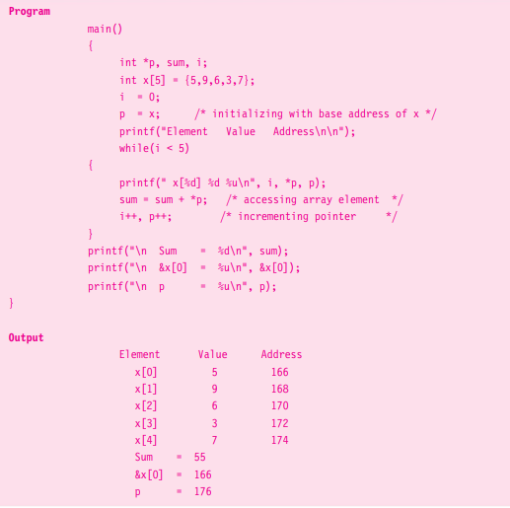
Pointer to Array
*
Programming and Data Structure
‹#›

Slide 73
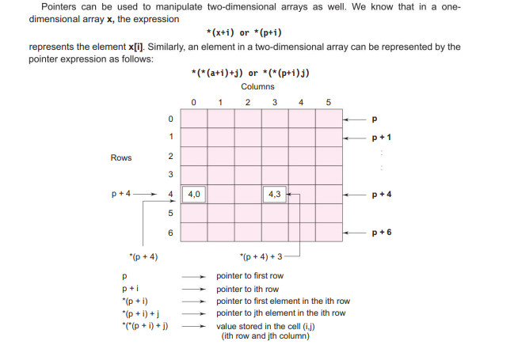
Pointer to 2D-Array
*
Programming and Data Structure
‹#›

Slide 74
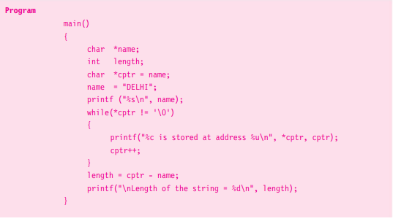
String Pointer
*
Programming and Data Structure
‹#›

Slide 75
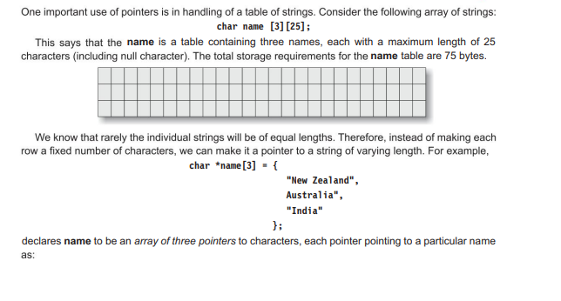
Array of Pointers
*
Programming and Data Structure
‹#›

Slide 76
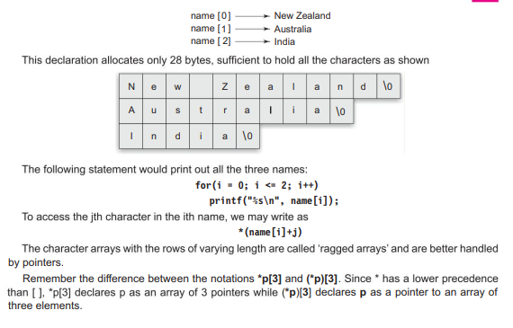
Cont..
*
Programming and Data Structure
‹#›

